Slide 1
Traverse Pharma
By,
Alka Bhatt, Naveen Dayakar, Khavya Ramachandran, Edmund Arthur

Slide 2
Company Background
American Pharmaceutical Company
One of the largest pharma company in the world
Around 20 years in the Pharma Industry
Producer of Generic Medicines
Manufacturer- medicines for diabetes, cholesterol, hypertension
Notes:
The company is a top producer of three drugs in the pharmaceutical market.
The company is a leader in the industry for almost more than 20 years.
Traverse Pharma (Modified Name) is aiming to find the best approach for maximizing the profits by analyzing its previous year’s performance.
As a generics company, with limited marketing efforts, the focus will be on the manufacturing, monitoring the company’s budget, to determine the products to acquire and producing the right amount of them to optimize revenue.
Traverse Pharma is a leading producer of three generic medicines for diabetes, cholesterol, hypertension.

Slide 3
Who is the customer?
Company produces three drugs on a major scale
Customers are people diagnosed with:-
Hypertension
Diabetes
High Cholesterol
Customers with above diseases, have to continue medicines for a longer time
Customers are skeptic to settle for a new medicine
They prefer to continue the same medicines they have been using
Notes:
The company is a top producer of three drugs in the pharmaceutical market.
The three drugs are used by customers diagnosed with diabetes, cholesterol and hypertension respectively.
Since the diseases require that the drugs have to be continued for a long time, customers usually prefer to continue with the same drug against a new one.
Doctors also prescribe the same brand of medicine for a particular generic, which they are comfortable with.
They do not prefer to change the brand which they suggested to the patients regularly.

Slide 4
Customer Expectations
The customers are people diagnosed with diseases that are critical
They need immediate attention
This means immediate medicine availability
Out-of-stock medicine situations are fatal for the customer’s health
Non-availability of medicines due to higher shipping times, out-of stock medicines, will cause customers to quit.
Notes:
The customers are people using the same medicine brand for a long time and almost on a daily basis.
The customers are dependent on the supply of the medicines and immediate availability.
The non-availability of the medicines or any delay, could possibly deteriorate the patient’s condition, lead to patients and doctors moving to another brand.
The dependability on the demand, will make sure that there is optimum quantity produced.
The forecasts for the demand will be accurate if the demand is steady.
If the medicines are not readily available, then there will be customers withdrawing from using the brand.
This will create a more fluctuating demand.

Slide 5
Company Expectations
The high volume of customers with diseases means high demand.
The customers have to continue the medicines for a longer time, means steady supply around the year expected
So, company has to produce more than what is expected
Inventory storage required in large quantities, longer time
Minimum shipping time required.
Notes:
This means that there should be minimum delay in shipping, manufacturing and other activities.
The company has to produce more than what is usually the demand, so that they do not lag behind.
If they lag, there will be situation where customers are not happy with the brand and will not prefer it in the future.
The company has to bear the inventory costs, though this is an extra burden.
Inventory storage will reduce the time needed to manufacture the medicines again.
Hence, less waiting time and more reliability for the customer.
This reliability is seen as future profit for the company.

Slide 6
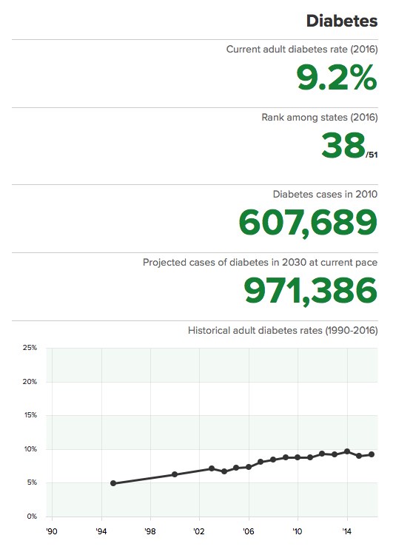
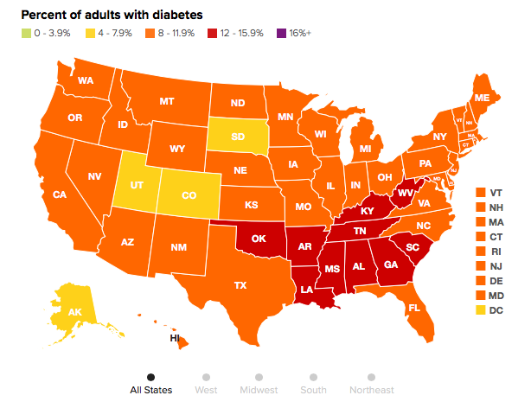
Diabetes
DIABETES IN NEW JERSEY
DIABETES VS. TOTAL POPULATION
Notes:
The graphs show the percentage of affected by diabetes in New Jersey alone.
The rank shows that New Jersey is not in the leading states where diabetic patients are more.
The map on the right shows the total population vs the diabetic patients per region.
The heat map gives an idea of where the diabetic patients are more in percentage.
The SE region is more compared to other regions.
So, the plant in New Jersey will do justice in the fairly short shipping time.
However, the company is concentrating on the production planning only.

Slide 7
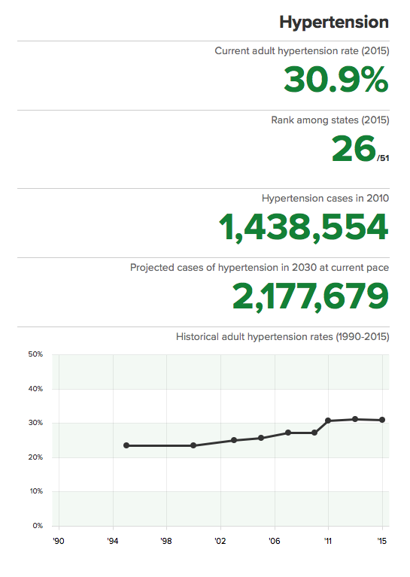
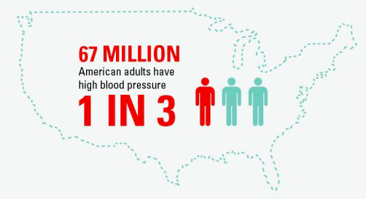
Hypertension
HYPERTENSION IN NEW JERSEY
HYPERTENSION IN USA
Notes:
Hypertension is very common amongst almost all. The statistics on the right demonstrates how common the condition is.
The statistics on the left shows the percentage of people affected in New Jersey alone.
Again, the rank is New Jersey is not very high indicating, there are more people affected by Hypertension in other states.

Slide 8
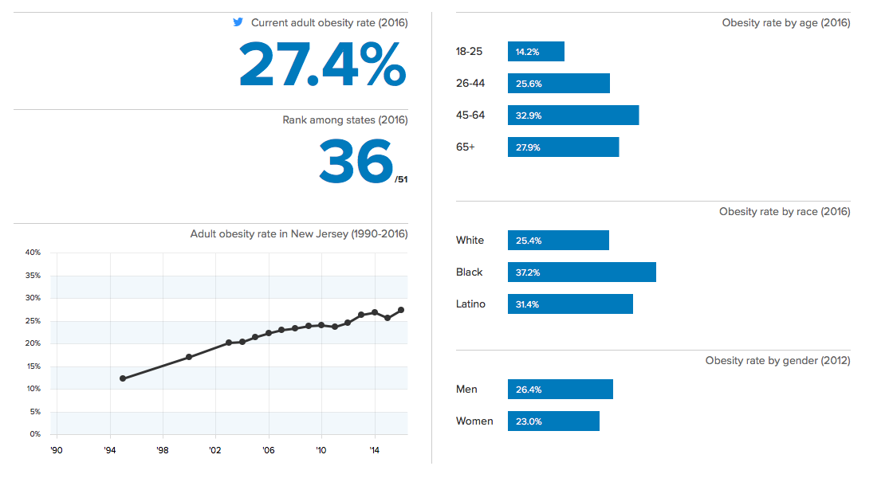
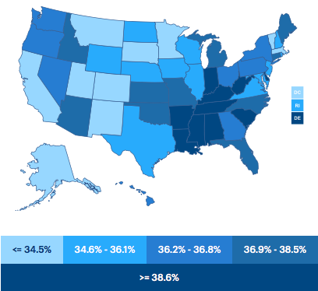
Cholesterol
HIGH CHOLESTEROL IN NEW JERSEY
HIGH CHOLESTEROL IN USA
Notes:
The graphs show the percentage of people having high cholesterol in New Jersey alone.
The rank shows that New Jersey is not in the leading states where people having high cholesterol are more.
The map on the right shows the total population vs the patients with high BP per region.
The heat map gives an idea of where the diabetic patients are more in percentage.
The SE region is more compared to other regions.
So, the plant in New Jersey will do justice in the fairly short shipping time.
Similar case as to the diabetic case.
Thus, the shipping of both the medicines can take place together since the higher concentration for both diabetes and high cholesterol patients are more in SE region.

Slide 9
Statement Problem
The company had faced many out-of-stock situations in New Jersey in the last years.
Caused more shipping times across the country and also more waiting time to receive the medicine
Resulted in customers shifting to other brands
Less number of repeat customers
Finally, Lead to less profit margin for the company
Notes:
It is clearly visible that all the medicines and the target customers, are large in number.
Furthermore, the criticality of the diseases pose a bigger problem. The company should not take risk in the production quantity.
There should be a steady supply of medicines, or an inventory that is ready to meet any excess demands than expected.

Slide 10
Statement Problem(continued..)
The company wanted to bounce back by producing more than the usual amount
This resulted in higher inventory storage quantity and storage time
Increased the inventory costs and
Lead to less profit margin for the company
Notes:
The company took steps to produce more to avoid out-of-stock situations.
But, it was not able to predict the demand the right way.
Sometimes, the over production let to more days and quantity in the inventory, which resulted in the medicines nearing their expiry dates.
This also led to more inventory costs and less profit margin for the company.

Slide 11
Objective
The company aims to avoid any shortage of drugs and aims to forecast the demands for the year keeping in mind any flexibilities of the demands.
The aim is to review the monthly demands of the previous years to predict the demand for the following year.
Calculate all the costs involved and plan to reduce it by producing the optimal amount.
Produce more drugs when the demand is forecasted to be high but not high enough in order to avoid stocking the drugs in the inventory over time. Simultaneously, produce the right amount of goods in order to avoid out-of-stock situations.
Notes:
This gives rise to a production planning problem, that will help produce the right amount and maximize profits for the company.
The objective is simple.
Forecast the demand for each medicine using the previous years demand data.
Produce a forecasted amount along with a little more buffer.
Consider all the cost constraints and find out the right number of medicines to produce to optimize the manufacturing process and also help the company achieve maximum benefits.

Slide 12
Action Plan
To forecast the demands as accurate as possible to manufacture the right amount of goods.
To find the right method for forecasting.
To find out the budget to be allocated for each drug separately and calculate manufacturing costs, number of medicines to manufacture etc., for each drug.
Maximize the profit of the company by producing the optimum amount of medicines only.
Find out all the constraints like budget for each drug, maximum and minimum values of production and other miscellaneous costs.
Keep all the constraints in equation and find out the optimized solution.
Use Linear programming to find out which drugs to manufacture in order to minimize the inventory cost, manufacturing cost etc.
Notes:
The action plan is a detailed breakdown of the objective.
The forecasting is based on the previous years of demand, calculated from the percentage of population affected with the diease and using the company’s products.
The right forecasting strategy should be chosen by taking into account the error percentage and the accuracy of the method.
The budget allocated for the production process of each medicine category, depends upon the profit of the company and contribution of that particular medicine to the company’s profit.
Keeping all constraints in mind , developing a linear programming model will give us the optimized production quantity for each of the medicines.

Slide 13
Conclusion

